Slide 1
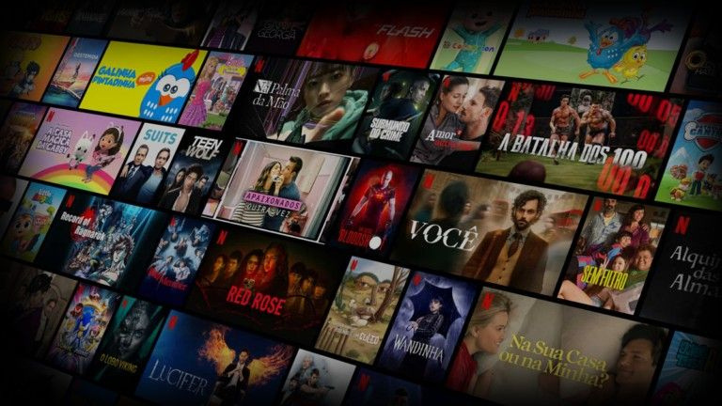
2025
IBM PROJECT
Netflix EDA
Exploratory Data Analysis Project
BY: Krittika Biswas
Mentor’s Name: Arif Hassan

Slide 2

Introduction:
This project conducts an Exploratory Data Analysis (EDA) on the Netflix movies dataset to uncover content trends and viewer engagement. The analysis focuses on release year patterns, popularity versus vote count, and content types, providing insights into how Netflixs catalog has evolved over time and which factors influence popularity.

Slide 3
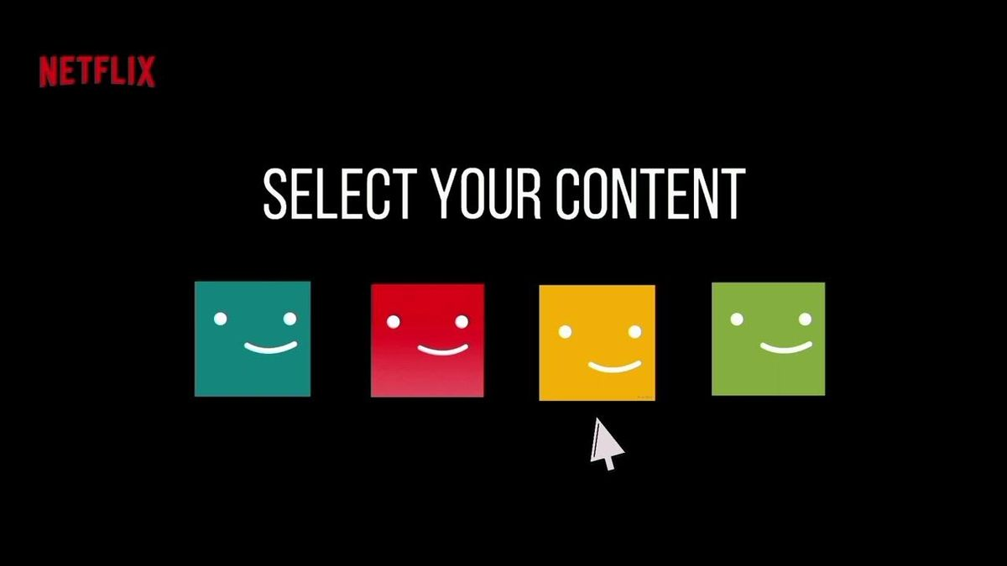
01
Netflix EDA Project
Overview

Slide 4
The main objectives are to analyze Netflix content trends over the years, examine relationships between popularity and vote counts, and identify content types released by Netflix. This helps in understanding viewer preferences and content strategy evolution. The scope includes data cleaning, visualization, and interpretation to drive actionable insights for content recommendation and investment decisions.
Project Objectives and Scope

Slide 5
The project utilized Python and Jupyter Notebook as the primary development environment. Key libraries included Pandas for data cleaning and manipulation, NumPy for numerical operations, and Matplotlib and Seaborn for producing visualizations. The analysis was performed on a cleaned Netflix movies dataset to ensure accurate insights.
Tools and Technologies Used

Slide 6
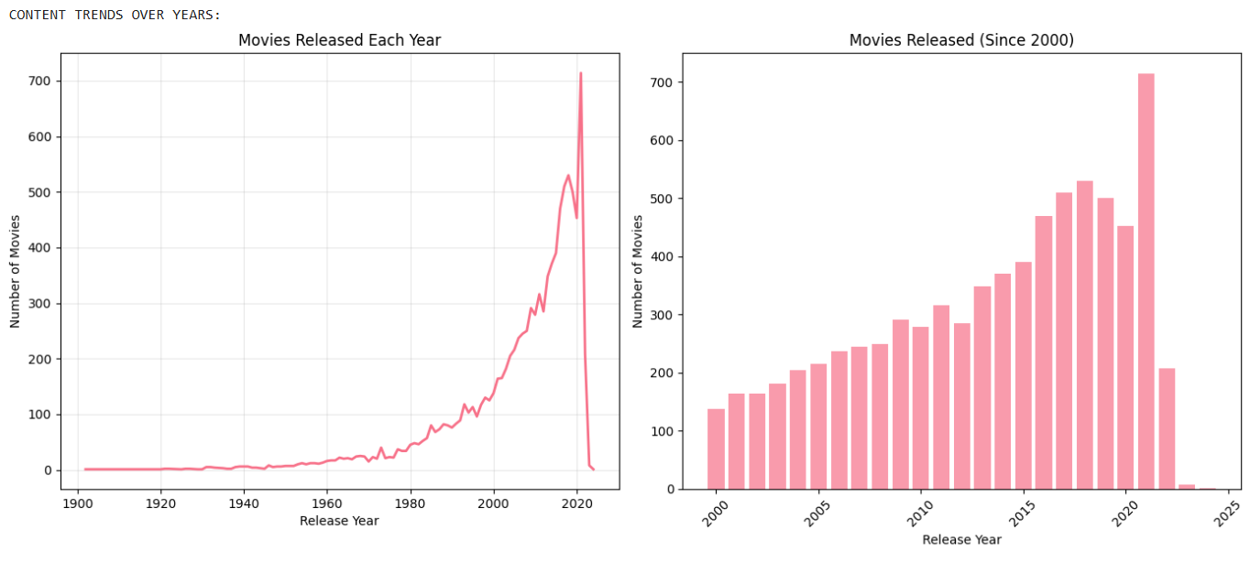
02
Project Working/Outputs
Content Trends Over the Years
Insights from the chart:
Number of movies released has grown dramatically, especially after 2000.
Sharp rise between 2015–2020, showing Netflix’s aggressive expansion.
Drop after 2021 due to dataset cutoff and post-pandemic slowdown.
Before 1950s, content production was extremely low.

Slide 7
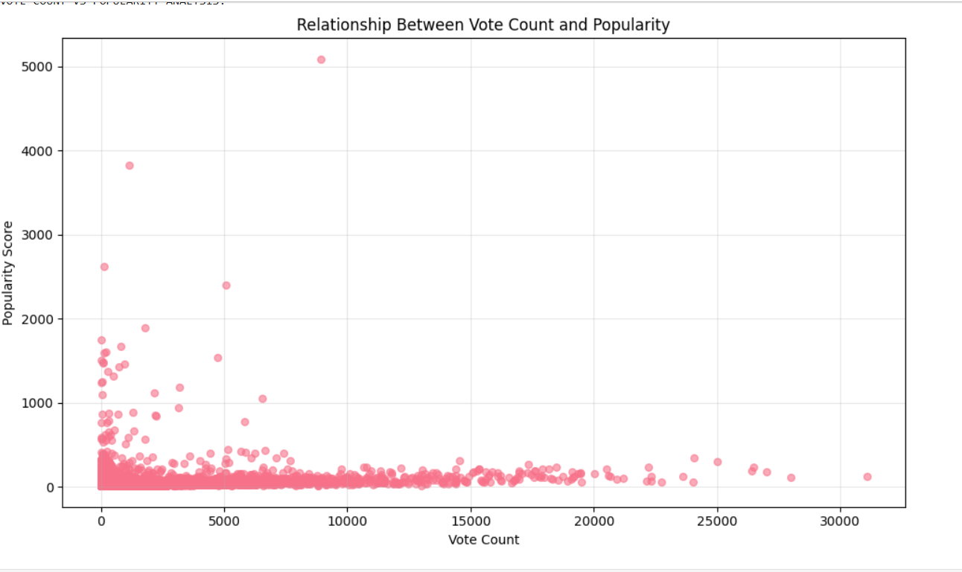
Vote Count vs Popularity Analysis
Insights from the chart:
Movies with very high popularity are not necessarily the ones with the highest vote counts.
Most movies cluster near low popularity and low vote count, meaning only a few titles dominate attention.
A few outliers show extremely high popularity despite moderate votes.
Relationship is weak → popularity depends on factors beyond votes (marketing, genre, timing).
Vote Count vs Popularity Analysis code
plt.figure(figsize=(10,6))
plt.scatter(df_clean['Vote_Count'], df_clean['Popularity']); plt.show()

Slide 8
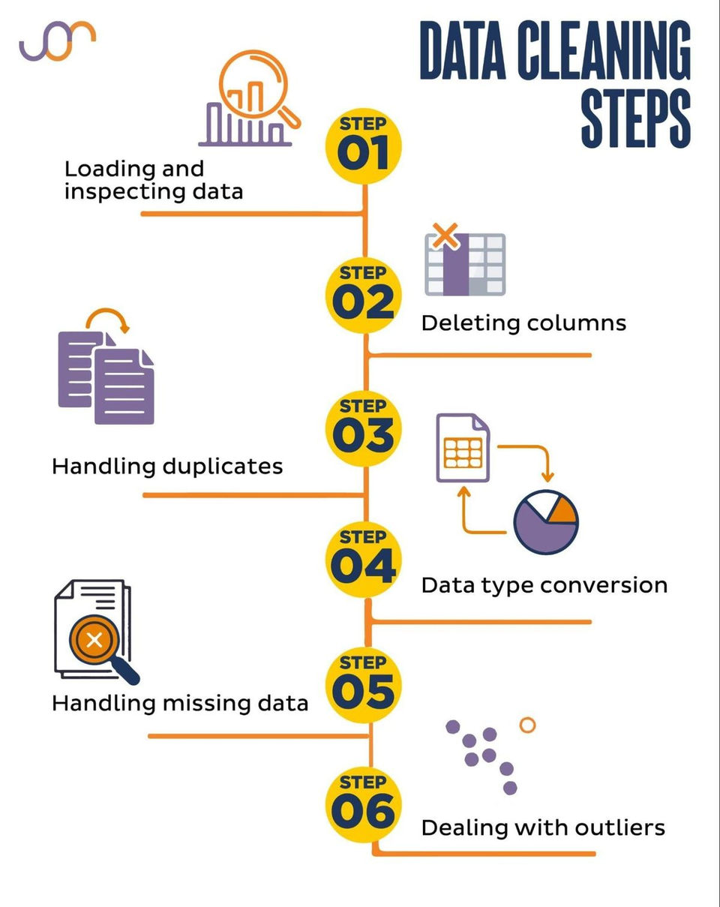
Data Cleaning Procedures
Data cleaning involved removing missing and invalid values, especially focusing on release years and popularity metrics. Columns were renamed for clarity, and data types converted to appropriate formats. Relevant fields like vote count, popularity, and release year were extracted for detailed analysis. These steps ensured data integrity for effective exploration.

Slide 9
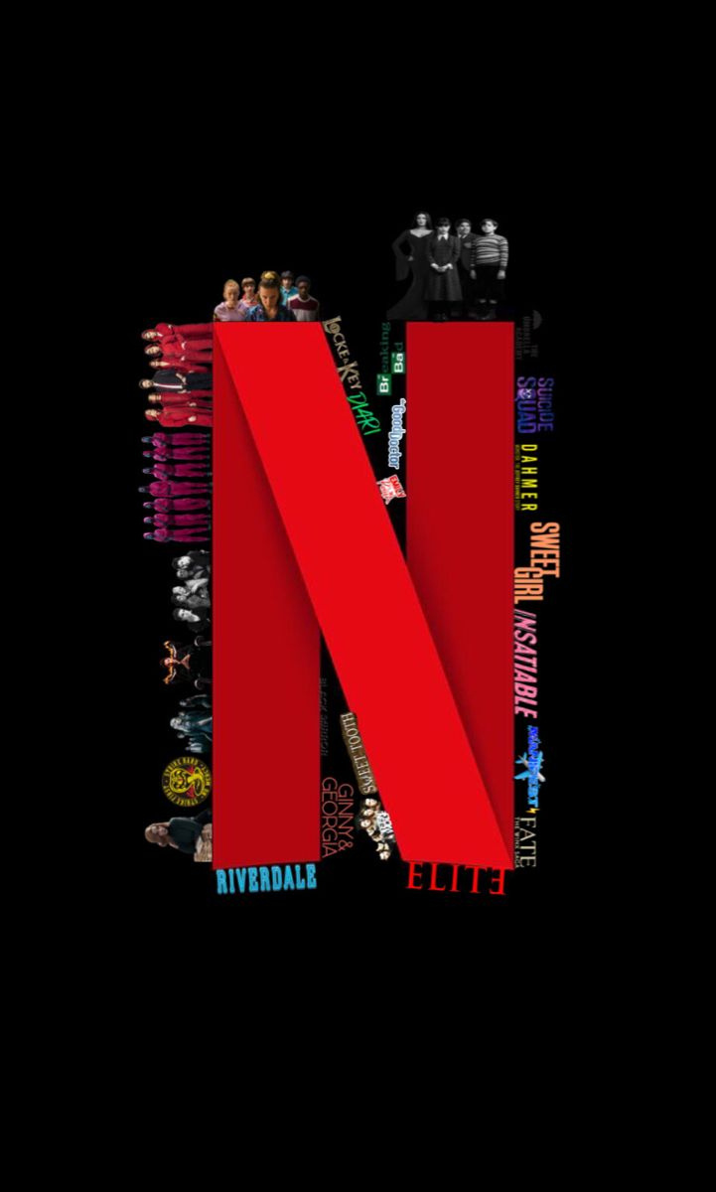
Analysis revealed a significant growth in content release after 2000, with a sharp increase from 2015 to 2020 due to Netflix’s expansion. Popularity and vote count showed weak correlation, indicating other factors like marketing impact popularity. The dataset also highlighted content distribution changes over time and the dominance of a few titles in viewer engagement.
Key Visual Insights and Patterns

Slide 10
  Helps identify what type of content gains the most popularity.
  Useful for content recommendation systems.
  Can help Netflix decide what kind of movies to invest in.
  Helps analysts see trends like which years had content growth.
  Useful for academic research on OTT platform content trends.
Applications and Future Directions

Slide 11
Problems Faced & Solutions:
  Problems
  Missing release year values
  Inconsistent or incorrect metadata
  Popularity and vote count skewed heavily
  Large number of low-value outliers
  Visual clutter due to dense scatter plot
  Solutions
  Cleaned null values
  Standardized year formats
  Applied filtering to remove invalid entries
  Used alpha transparency to reduce scatter plot overcrowding
  Used separate visualizations for pre-2000 and post-2000 data

Slide 12
  Apply machine learning models to predict popularity.
  Build a recommendation system using clustering or collaborative filtering.
  Add genre-wise popularity analysis.
  Compare Netflix data with other OTT platforms.
  Build an interactive dashboard using Tableau / PowerBI / Streamlit.
Future Scope

Slide 13

https://github.com/richebiswas/EDA-on-Netflix-Movies-TV-Shows
THANK
YOU

